Slide 1
“New Take” Symbol for Rick.

Slide 2
Planning Your Program Objectives
Funded by Multistate Conservation Grant Program
Phil Seng
President
DJ Case & Associates

Slide 3
Setting Objectives
Most important part of planning a program!
"If you don’t know where you're going, any road will get you there"
Be very intentional
What do you want your locavore program to do?

Slide 4
Exercise: Objectives
What are your objectives for your locavore program?
Does your state require any additional objectives?
Do your partners require any additional objectives?
Do your funding sources require any additional objectives?

Slide 5
Refining Objectives - Make 'em SMART

Slide 6
Refining Your Objectives
Create license buyers

Slide 7
Refining Your Objectives
Create license buyers
Create 1,000 new license buyers by March 1, 20XX

Slide 8
Refining Your Objectives
Create 1,000 new license buyers by March 1, 20XX
Create new conservation supporters
Create mentors for the community

Slide 9
Final Objectives
Create 1,000 new license buyers by March 1, 20XX
Retain 75% of new license holders through March 1, 20XX
Register 10% of license buyers as mentors by March 1, 20XX

Slide 10
Steps to Meet Each Objective
Create 1,000 new license buyers by March 1, 20XX
Students attend panfish fishing training
Students understand panfish biology/behaviors
Students learn/understand fishing techniques
Students receive social support as anglers
Students go fishing
Retain 75% of new license holders through March 1, 20XX
Graduates receive social support as anglers
Graduates see themselves as anglers
Graduates have multiple fishing opportunities
Register 10% of license buyers as mentors by March 1, 20XX
Graduates stay involved in program
Graduates see value in involving others in angling.

Slide 11
Actions to Achieve Each Step
Create 1,000 new license buyers by March 1, 20XX
Students attend panfish fishing training
Messages reach & motivate potential students
Potential students sign up for class(es)
Students attend class(es)
Students understand panfish biology/behaviors
Students learn fish biology/behaviors
Students learn/understand fishing techniques
Students learn fishing techniques
Students develop fishing skills
Students receive social support as anglers
Instructor provides social support
Classmates provide social support
Friends and family of students provide social support
Students go fishing
Provide fishing experience
Assign fishing “homework.”

Slide 12
Exercise: Steps and Actions for Objectives
List the steps necessary to reach each of your objectives
List the actions necessary for you to complete each of your steps.

Slide 13
Inventory
Take inventory of what you already have
Don't reinvent the wheel if you don't have to
(recognize that you might have to).

Slide 14
Exercise: Part 1: R3/Locavore Inventory
What types of hunting/fishing-related programs do YOU personally teach now?
What types of hunting/fishing-related programs does YOUR STATE/ORGANIZATION offer now?
Circle the programs that could serve as a foundation for your locavore program.

Slide 15
Exercise: Part 2: R3/Locavore Inventory
How many instructors does your state/organization have who could conceivably be called on to teach a locavore course?
List 3 to 5 potential instructors for a food-oriented hunting or fishing class.
(Remember, this is NOT your "traditional" audience!)
(Instructors need to be versatile).

Slide 16
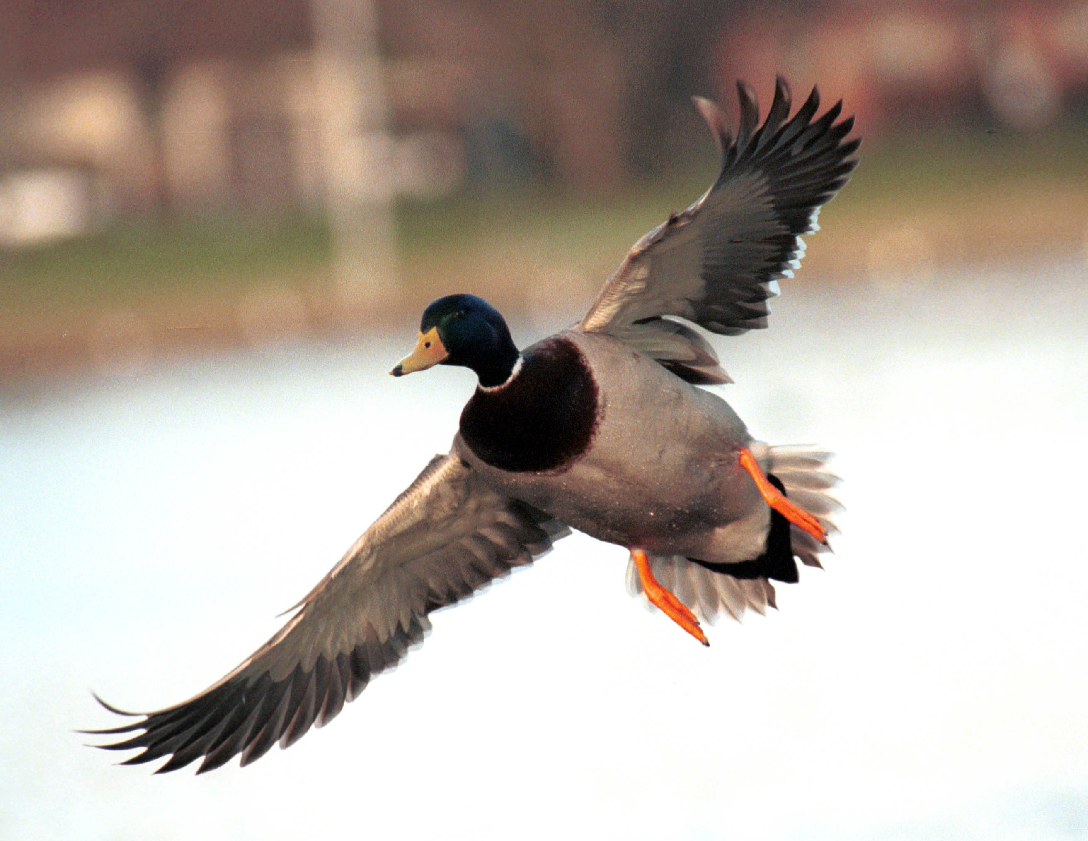
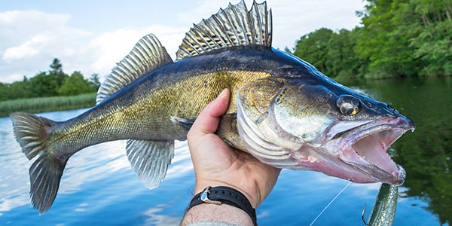
Exercise: Part 3: R3/Locavore Inventory
What are the 4 most popular game species in your state?
Circle those you feel should be featured in a locavore program.
What are the 4 most popular game/eating fish in your state?
Circle those you feel should be featured in a locavore program.

Slide 17
Funded by
Multistate Conservation Grant Program

