Slide 1
“New Take” Symbol for Rick.

Slide 2
Attracting Students: Messaging
Funded by Multistate Conservation Grant Program
Matt Harlow
Engagement Strategist
DJ Case & Associates

Slide 3
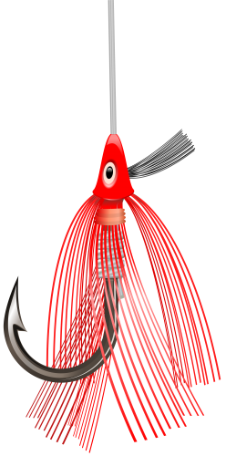
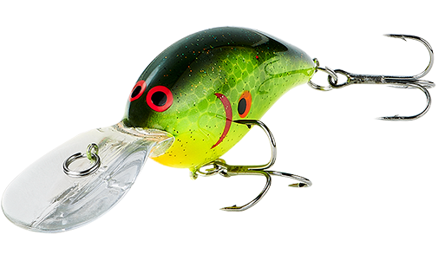
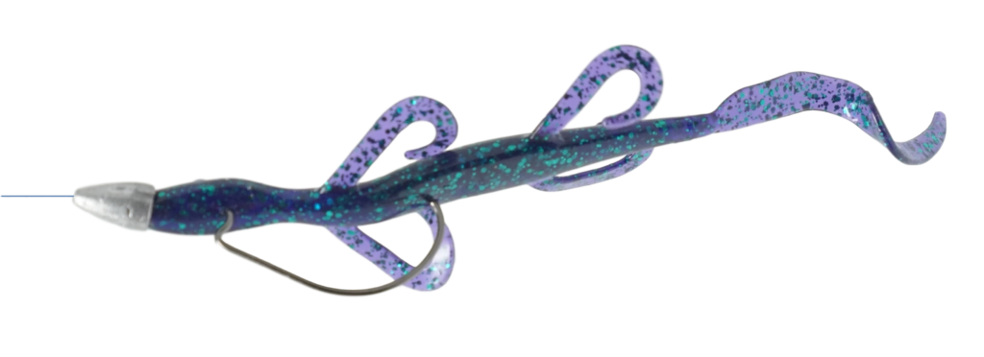
Your Message is the Bait

Slide 4
How does a message work?
Attention
(Motion, Noise, Flash)
Communication
(Hey, that looks like food!)
Call to Action
(Hook - If they see the message and like what it says, what do they do next?)

Slide 5
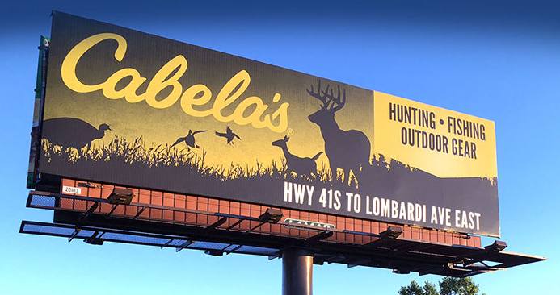
How does a message work?
Attention
(Motion, Noise, Flash)
Communication
(Hey, that looks like food!)
Call to Action
(Hook - If they see the message and like what it says, what do they do next?)

Slide 6
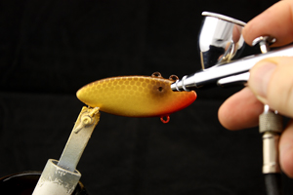
Crafting a Message

Slide 7
Crafting a Message – Get Their Attention
Attention
(Motion, Noise, Flash)
Communication
(Hey, that looks like food!)
Call to Action
(Hook - If they see the message and like what it says, what do they do next?)

Slide 8
Get Their Attention – Relevant Attention
Something you gain by using the product
Something you will lose by not using the product.

Slide 9
Get Their Attention – Borrowed Interest
Cute
Controversy
Celebrity
Song.

Slide 10
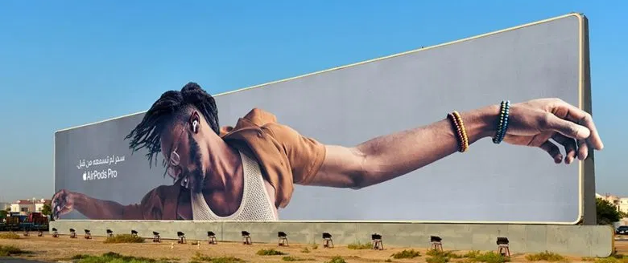
Get Their Attention – Stand Out Graphically
B&W among color
Silence on TV
Clean white design
Unique, attractive image.

Slide 11
Exercise: Attracting Attention
How could you attract attention to ads for your program?
2 Relevant Attention
2 Borrowed Attention
2 Graphic Attention

Slide 12
Crafting a Message – Communication
Attention
(Motion, Noise, Flash)
Communication
(Hey, that looks like food!)
Call to Action
(Hook - If they see the message and like what it says, what do they do next?)

Slide 13
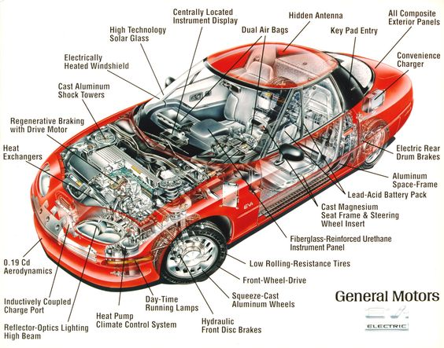
Keep Your Message Simple!

Slide 14
Keep Your Message Simple!
FAST

Slide 15
Keep Your Message Simple!
What can you tell me about car #1?
What can you tell me about car #2?

Slide 16
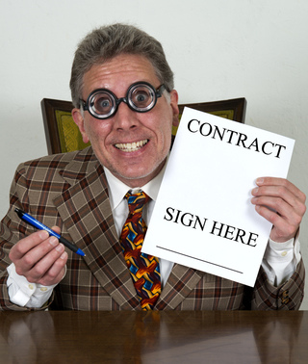
Don’t Oversell
Sell the next step. Not the last step.

Slide 17
Features and Benefits
Feature: something your product/service has or is
Benefit: outcomes or results of using your product/service
(Sometimes the lines are blurry and that’s okay)
Feature: Fishing is easy enough that kids can do it
Benefit: Spend time with your family
ALWAYS from the prospect’s point of view!

Slide 18
Common Motivations
Hunting
Fun, relaxation, sport
Being in nature/outdoors
For the food
To be with family and/or friends
Fishing
Being in nature/outdoors
To be with family and/or friends
I fished as a child/tradition
Inexpensive activity
To unplug/be alone
Adventure and excitement
Easily accessible
For the food
Source: Hunting, Fishing, Sport Shooting, and Archery Recruitment, Retention, and Reactivation. A Practitioners Guide. National Shooting Sports Foundation and Responsive Management

Slide 19
Messages to Take Advantage of Motivations
What can you do with your prospects’ motivations?
“Greed” messages: If you do X, you will get more of Y
If you go fishing/hunting, you get:
Fun
Recreation
Time with friends and family
Natural protein
Etc.

Slide 20
Common Barriers/Obstacles
Hunting
No time
Poor health/age
Lack of access
Weather
Lost interest
Fishing
Not catching any fish
Crowded spots/Lack of access
Hassle
Cleanliness of water (and shoreline)
Lack of knowledge
Lack of equipment
Source: Hunting, Fishing, Sport Shooting, and Archery Recruitment, Retention, and Reactivation. A Practitioners Guide. National Shooting Sports Foundation and Responsive Management

Slide 21
Messages to Overcome Barriers/Obstacles
Correct misconceptions (You really can eat the fish from Lake Erie.) (There is public hunting land within 25 miles of downtown.)
Tell how your program solves the problem (We will teach you how to shoot and help you find an affordable gun.)
Address “discomforts” with testimonials, case studies and/or images of similar-looking people
Turn the tables on “bad excuses not to go” (When she grows up do you want her to remember that you worked a lot of overtime or that you took her fishing?).

Slide 22
Exercise: Features (and Benefits)
List the 5 most important features of your program (from the participants’ viewpoint)
How do participants benefit from each feature?

Slide 23
Crafting a Message – The Hook
Attention
(Motion, Noise, Flash)
Communication
(Hey, that looks like food!)
Call to Action
(Hook - If they see the message and like what it says, what do they do next?)

Slide 24
What Are We Motivating Them To Do?
Ultimately, what do you want your prospects to do?
Angler training – so they can buy a license and go fishing
Is it reasonable to expect your prospects to take that action after only seeing a message?
Probably not
What is a reasonable next step a prospect might take after seeing your message?
Go to your website; call a number; visit a FB page
THAT is the call to action.

Slide 25
Using Your Call-To-Action Effectively
One call-to-action per message
Make a reservation for a wild game dinner
Get more information
Check the schedule
There can be more than one method of taking that single action
Phone number
Email
Website
100% of message dedicated to encouraging the call-to-action
Anything else is just a distraction.

Slide 26
Exercise: Call-to-Action
What do you ultimately want prospects to do?
What do you want them to do as a result of your message?
List all the ways they could take/do your call to action.

Slide 27
Message Chain
Call for Information
Make Reservation for Wild Game Dinner
Attend Dinner & Receive Information
Original Message
Click for Information
Receive Information
Sign up for a Class
Email for Information
Messages needed to walk a prospect from first exposure to sign up
Each step has its own call to action.

Slide 28
Exercise: Message Chain
List the steps from first message to signing up for your program
What information is needed at each step?
What is the call to action at each step?

Slide 29
Constant Refinement
Go fishing! (Use your messages)
If you aren’t getting enough bites
Change your bait (Messages)
Change your location (Media)
Don’t change both at once
Watch and learn
Keep what works
Refine or eliminate what doesn’t
Your marketing will never be perfect, but it will always be improving.

Slide 30
Funded by
Multistate Conservation Grant Program

Slide 31
“New Take” Symbol for Rick.

